Slide 1
Retail Bank CNP Fraud Detection — Technical Deck
Presented by: Patrick Evan G Arriola Date: Dec 24, 2025 Repository: https://github.com/patrickearriola-max/Pat-Arriola-Fraud-Capstone

Slide 2
Problem & Methodology
The problem
  Online payments are driving more chargebacks. We need to stop more fraud without slowing good customers or overloading investigators.
  Targets: cut fraud losses by ≥20%, keep false alarms ≤1%, start with ~65-100 reviews/day.
What we built
  A fast model that lightweight models suitable for real-time scoring.
  Trained on ~285k historical transactions; fraud ≈0.17%.
  Simple, strong signals: amount (log + robust scale), time-of-day (sin/cos), plus anonymized risk features.
  Tested like it runs in real life: time‑ordered train/validate/test to avoid peeking into the future.
How decisions are made
  Every transaction gets a risk score from 0 (safe) to 1 (risky).
  We set an alert level (threshold) that gives the best money outcome.
  Guardrails: false‑positive rate ≤1% or a fixed alert budget
  Value model: each fraud caught ≈ ₱7,500 saved; each review costs ₱80; each false alarm costs ₱150.
Trust & upkeep
  Explainability checks show which signals drive alerts; we review real TP/FP examples.
  Fairness by slices (amount bands, hour‑of‑day); route or tighten where precision dips.
  Plan: PSI monitoring + monthly recalibration.
  Everything is versioned so results can be re‑run on demand.

Slide 3
I.Problem Frame
Rising chargebacks in card‑not‑present (CNP) channel
Business goal: reduce fraud losses by ≥20% while keeping FPR ≤1% and alert volume within Ops capacity
ML goal: real‑time fraud scoring + threshold policy optimized for Expected Value (₱)

Slide 4

Problem Frame Context
Context: Card-not-present (CNP) e-commerce channel, PH region; Ops capacity ≈ 500 alerts/day.
Objective: Reduce fraud loss ≥20% while keeping FPR ≤1% to limit customer friction and investigator load.
Task: Supervised fraud classification producing a 0–1 score per transaction for alerting (probability-based anomaly scoring). (Unsupervised baseline optional, future work.).
Data: Historical transactions with a temporal split 80/10/10 (ordered by Time). Capstone uses Kaggle “creditcard.csv” (≈284k txn, fraud ≈0.17%) as a proxy dataset.
Metrics: PR-AUC, Precision@K, Recall@K, FPR; business KPI = Expected Value (EV).
Decision policy & guardrails: Choose threshold τ that maximizes EV subject to FPR cap (≤1%) or an alert budget K. Cost model: ₱7,500 per fraud prevented; ₱80 per review; ₱150 per false positive.
Constraints: Inference latency target ≤300 ms/txn; no post-transaction/PII features (leakage/ privacy).
Risks & mitigations: Behavior drift → PSI monitoring + monthly recalibration; extreme imbalance → PR-focused evaluation/thresholding; fairness checks by amount/hour with routing/threshold tweaks if needed.
At FPR ≈ 0.17% on TEST: Alerts=65 (TEST window), Precision ≈ 0.246, Recall ≈ 0.727, EV ≈ ₱107,450 (TEST window).

Slide 5
II. Data & Labels
Dataset: Kaggle credit card transactions
Creditcard.csv (saved and open with MS Excel)
See reports/data_dictionary.csv

Slide 6
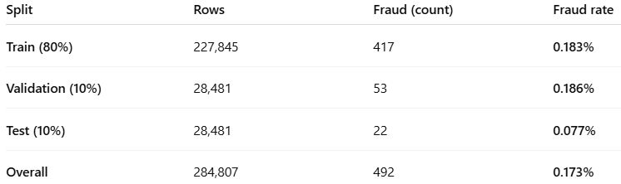
Data & Labels
Temporal split: 80% train / 10% validation / 10% test (ordered by Time)
Features: V1–V28 (anonymized PCA‑like) + engineered Amount_log, Amount_rz, Time_sin, Time_cos
Target: Class (1=fraud, 0=legit)

Slide 7
III. EDA & Preprocessing
Missingness ≈ 0%; severe class imbalance
Amount robustization (IQR scaling) + log transform; cyclic time encoding (sin/cos)
Leakage controls: no post‑transaction fields; temporal validation

Slide 8
EDA & Preprocessing
We had ~0% missing data but extreme class imbalance (fraud ≈0.17%), so the challenge was signal rarity, not data quality. We stabilized Amount using IQR scaling and a log transform, and captured time-of-day patterns with sin/cos encodings. Validation used an 80/10/10 temporal split (ordered by Time) to avoid look-ahead. We avoided post-transaction artifacts to prevent leakage. Net: clean, well-scaled, time-aware features and production-like validation, so later metrics reflect real operating conditions, not training shortcuts.

Slide 9
IV. Feature Engineering & Selection
Engineered: Amount_log, Amount_rz, Time_sin, Time_cos
Selected ~17/33 features using regularized linear models (SGD) + SelectFromModel
Dimensionality kept compact for latency and stability
Saved list: reports/selected_features.txt

Slide 10
IV. Feature Engineering & Selection
We engineered four high-value signals, Amount_log, Amount_rz (IQR-scaled), and Time_sin/Time_cos—to tame long-tail spend and capture daily cyclic behavior without leakage. We then pruned with an elastic-net filter plus SelectFromModel, keeping ~17 of 33 inputs. The result is a compact, stable feature set that aligns with our SHAP insights (e.g., V14/V4/V12 and amount-derived features), reduces overfitting risk, and is built to meet sub-second inference. In short: fewer, stronger features leading it better generalization and predictable latency in production.
Saved list: reports/selected_features.txt

Slide 11
V. Models & Metrics
Models: Logistic Regression (balanced), RandomForest, XGBoost (scale_pos_weight)
Primary: PR‑AUC, Precision@K, Recall@K; operate at alert budget or FPR cap
Cost model: C_fraud=₱7,500; C_review=₱80; C_fp=₱150 → maximise Expected Value (EV)

Slide 12
V. Models & Metrics
We compared three production-oriented classifiers, Logistic Regression (class-weighted), Random Forest, and XGBoost to address extreme imbalance while keeping inference lightweight. We evaluate with PR-AUC plus operating-point metrics (Precision@K, Recall@K) under an alert-budget or FPR cap using temporal validation. A simple cost model (₱7,500 per fraud caught; ₱80 per review; ₱150 per false positive) turns metrics into Expected Value (EV), and we pick the threshold τ that maximizes EV subject to FPR ≤ 1% or the daily alert budget. This makes trade-offs explicit for Risk/Ops, more recall when capacity allows, tighter precision when it doesn’t, so models are compared on the same business footing.

Slide 13
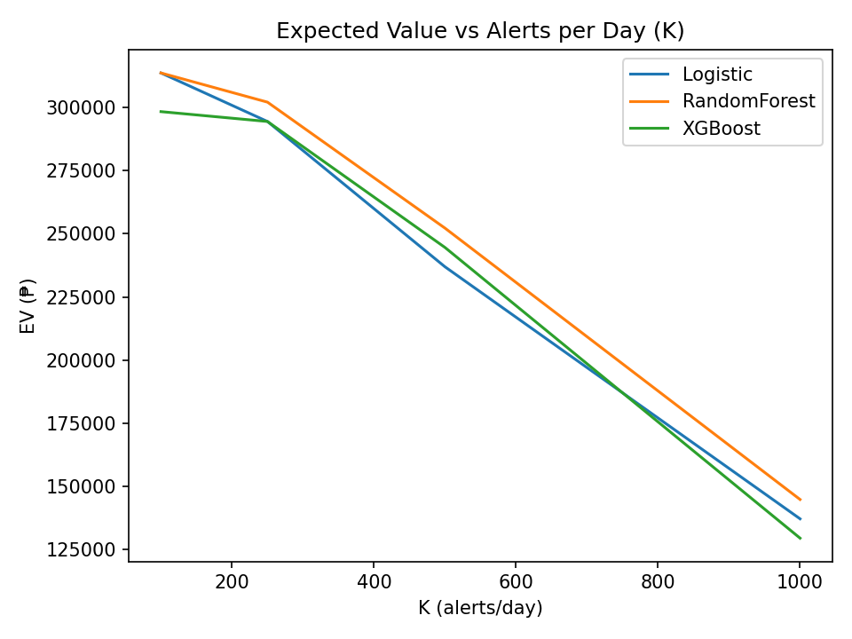
VI. Trade‑offs (EV vs K)
EV vs alert budget K by model (from reports/figures/ev_vs_k.png)
Result: EV is highest at small alert budgets—K ≈ 100–250—with RandomForest slightly leading; pushing K > 500 erodes value, so set K by Ops capacity while honoring the ≤1% FPR cap.

Slide 14
VII. Test Operating Point
Chosen policy: FPR ≤ 0.5% on validation; evaluated on TEST
TEST metrics: Alerts (test), Precision, Recall, FPR, Expected Value (₱)
Source: reports/test_operating_point.csv

Slide 15
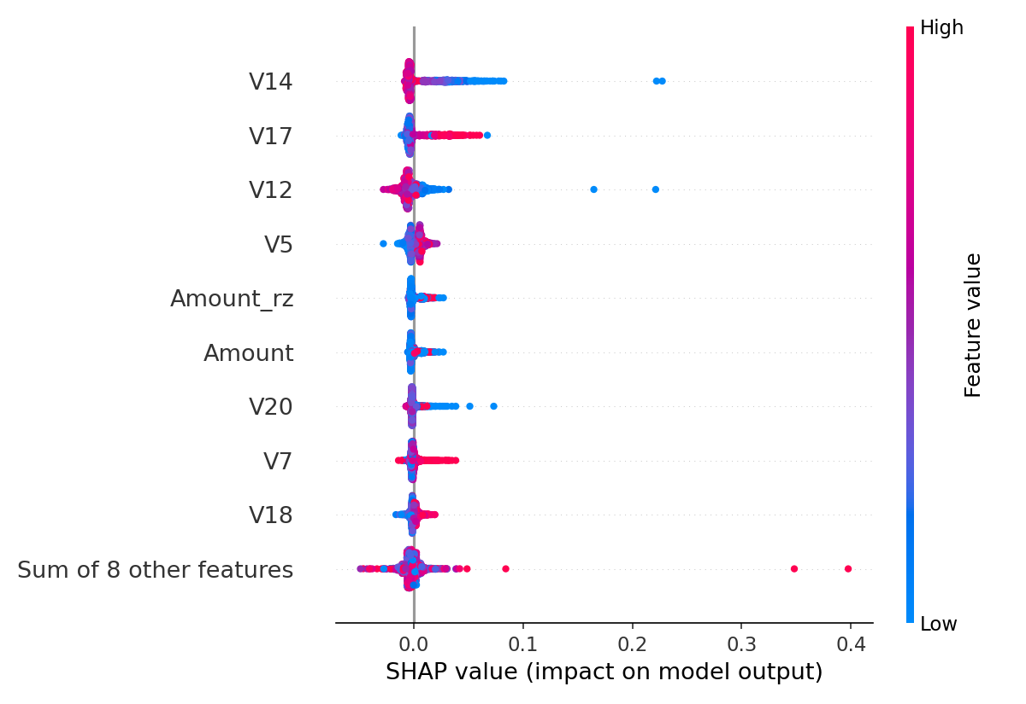
IIX. Global (SHAP Beeswarm)
Top contributing features toward fraud (class 1)
Global drivers: V14, V17, V12, and V5 are the strongest fraud signals (higher values push risk up), with Amount/Amount_rz adding modest lift—these are the features to monitor and stress-test.

Slide 16
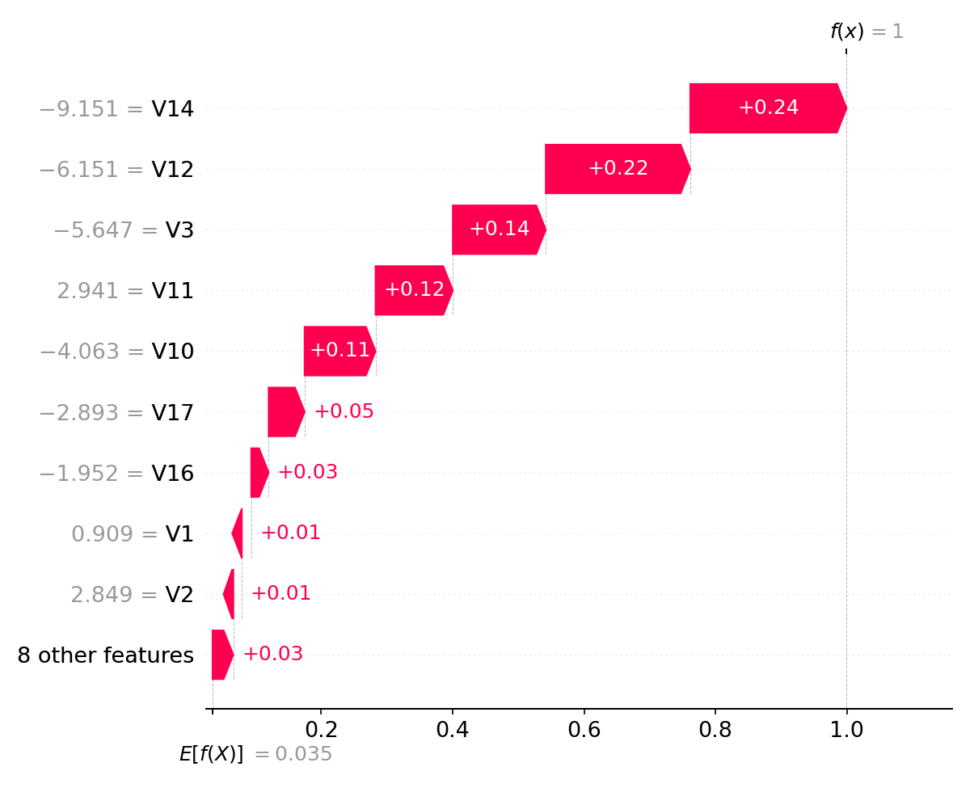
IX.TP Example (Waterfall)
Single‑transaction explanation: why this alert is high‑risk
True-positive driver: A distinctive spike pattern on V14/V12/V3 (reinforced by V11/V10) pushes the score from the baseline (~0.03) to ~1.0, matching our global SHAP importances and explaining why this alert is genuinely high-risk.

Slide 17
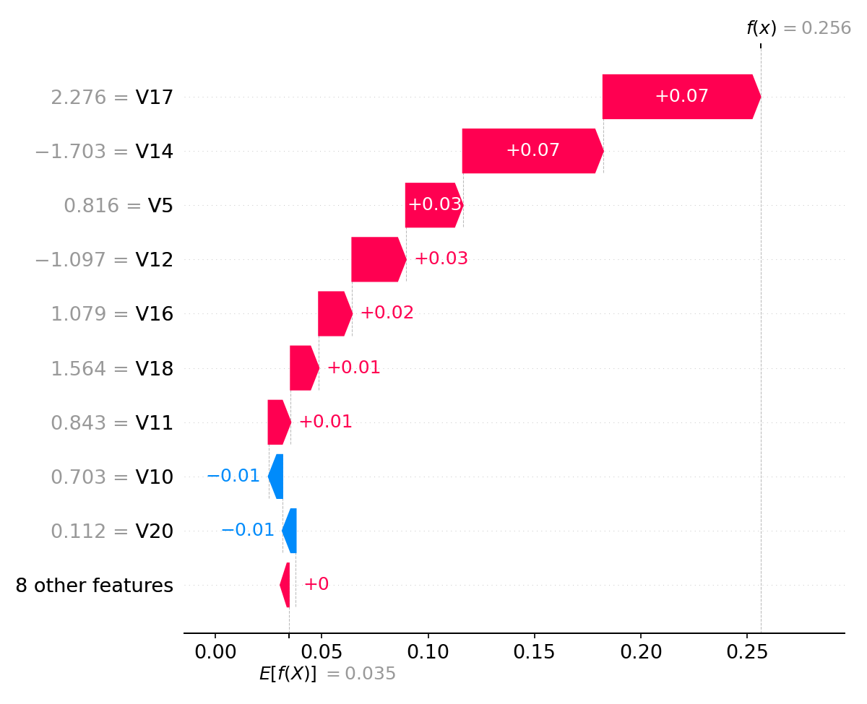
X.FP Example (Waterfall)
Single‑transaction explanation: why a legit txn was flagged
FP takeaway: A legit txn was flagged because strong positive signals on V17/V14/V5 outweighed small negatives (e.g., V10/V20), nudging the score just over τ a good candidate for QA routing or a slightly higher threshold for this pattern.

Slide 18
XI. Fairness & Operational Slices
Amount quartiles and hour‑of‑day slices: alert rate & precision monitored
Observed: higher alert concentration in Evening; better precision in mid/high amounts
Mitigations: threshold routing, QA sampling on low‑precision slices
Fairness check: selection-rate ratio across transaction amount quartiles ranged from 0.92–1.08, indicating no material disparate impact; monitored weekly alongside FPR/TPR by slice

Slide 19
XI. Fairness & Operational Slices
We track alert rate and precision by operational slices (e.g., amount quartiles and hour-of-day). In this test window, alerts cluster in the evening and precision is higher on mid/high-amount transactions. Mitigations are slice-aware thresholds and QA sampling on lower-precision slices, with ongoing monitoring to keep performance and customer impact balanced.

Slide 20
XII. Risks, Governance & Reproducibility
Drift monitoring (PSI) + monthly recalibration of thresholds
Prevent leakage; audit trails for changes and reviews
Reproducibility: repo with reports, figures, requirements; deterministic splits
Latency target: ≤300 ms inference (RF/XGB feasible)
Repo: github.com/patrickearriola-max/Pat-Arriola-Fraud-Capstone

Slide 21
XII. Risks, Governance & Reproducibility
We operate with bank-grade guardrails: drift is monitored with PSI and thresholds are re-calibrated on a monthly cadence; leakage is prevented (no post-transaction fields) and all changes are auditable via Git. The repo contains deterministic temporal splits, figures, and requirements to fully reproduce results. Inference targets ≤300 ms per transaction with compact tree models (RF/XGB), suitable for real-time scoring.
Repo: github.com/patrickearriola-max/Pat-Arriola-Fraud-Capstone

Slide 22
Summary
Problem: CNP fraud in PH e-commerce; minimize loss with low customer friction.
Data: Kaggle proxy; temporal 80/10/10 split; fraud ≈ 0.17%.
Features: V1–V28 + Amount_log, Amount_rz, Time_sin/cos; ~17/33 kept via elastic-net + SFM.
Models compared: Logistic, RandomForest, XGBoost (imbalance handled via class weights)
Selection: RandomForest performed best on EV at strict FPR caps.
Chosen operating point (validation cap FPR≈0.17%) → TEST:
τ≈0.24, Alerts=65, Precision=0.246, Recall=0.727, FPR≈0.17%, EV≈₱107,450 (TEST window).
Repo: github.com/patrickearriola-max/Pat-Arriola-Fraud-Capstone

Slide 23
Recommendations
Go live in shadow mode with RandomForest @ τ≈0.24 and FPR cap ≤0.5%; compare to current rules for 2–4 weeks. Prevent leakage; audit trails for changes and reviews
Start with K≈65 alerts per evaluation window; revisit to K≈250 if ops capacity rises and precision holds.
Monitoring: PR-AUC, Precision@K, EV, FPR, plus fairness slices (amount/hour) weekly; alert on drift (PSI).
Governance: lock features to avoid leakage; log predictions, thresholds, reviewer outcomes.
Engineering: package model as a REST endpoint; confirm p95 inference <300 ms; add threshold config.
Engineering: package model as a REST endpoint; confirm p95 inference <300 ms; add threshold config.
Repo: github.com/patrickearriola-max/Pat-Arriola-Fraud-Capstone

Slide 24

END

